Slide 1
CS61C: Great Ideas in Computer Architecture (aka Machine Structures)
Lecture 19: Single-Cycle Datapath II
Instructors: Lisa Yan, Justin Yokota

Slide 2
Agenda
Implementing Loads
Implementing Stores
Implementing Jumps
Implementing Branches
Implementing U-types
Implementing ImmGen

Slide 3
Datapath so far
+
4
dataW
rsW
rs1 data1
rs2
data2
Reg[]
dataR
addr
IMEM
A
ALU
B
PC
0
ImmGen
1
ALUSel
RegWEn
BSel
Control Logic

Slide 4
Agenda
Implementing Loads
Implementing Stores
Implementing Jumps
Implementing Branches
Implementing U-types
Implementing ImmGen

Slide 5
Implementing the lw instruction
Let's add lw
lw computes one thing:
addr = rs1 + imm
Adding rs1+imm can be done using ALU in current datapath
And affects two state elements:
rd = data at addr (4 bytes)
PC = PC+4
Requires adding DMEM after ALU, but before writing back to register

Slide 6
Datapath running lw x8 24(x2): IF, ID, EX
+
4
0x01812403
dataW
rsW
rs1 data1
rs2
data2
Reg[]
dataR
addr
IMEM
8
A
ALU
B
PC
0x7FFF FFE0
2
24
0x7FFF FFF8
52
0
rs2 gets computed from garbage instruction data, but doesn't affect overall circuit. Values stored in x2 and x24 were chosen arbitrarily for this example.
24
ImmGen
1
ADD
1
Control Logic

Slide 7
Datapath running lw x8 24(x2): IF, ID, EX, MEM
+
4
0x01812403
dataW
rsW
rs1 data1
rs2
data2
Reg[]
dataR
addr
IMEM
8
A
ALU
B
PC
0x7FFF FFE0
2
24
0x7FFF FFF8
52
0
dataR
addr
DMEM
dataW
DMEM output arbitrarily chosen. Clock wires omitted.
24
0xDEAD BEEF
ImmGen
1
ADD
1
Read
Control Logic

Slide 8
Datapath running lw x8 24(x2)
0xDEAD BEEF
+
4
0x01812403
dataW
rsW
rs1 data1
rs2
data2
Reg[]
dataR
addr
IMEM
8
A
ALU
B
PC
0x7FFF FFE0
2
24
0x7FFF FFF8
52
1
0
dataR
addr
DMEM
dataW
0
Note that the WB Mux at the end uses 0 for the bottom and 1 for the top. This order is arbitrary, and you may choose any order. All exams will use the order specified on the reference card.
24
0xDEAD BEEF
ImmGen
1
ADD
1
1
Read
0
Control Logic

Slide 9
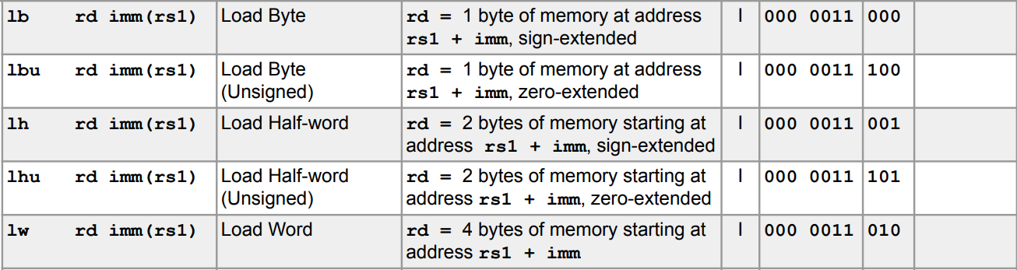
DMEM Limitations
To simplify its circuitry, DMEM can ONLY access 32 bits at a time
Regardless of what load/store instruction you have, dataW and dataR will always be 32-bits long.
Even further, many RISC-V DMEMs (including the one we provide for Project 3) have a further restriction that the DMEM can only access addresses that are a multiple of 4.
Ex. You can access address 0xFFFF FFFC to get the data from 0xFFFF FFFC to 0xFFFF FFFF, but not 0xFFFF FFFD

Slide 10
DMEM Limitations Affect Programming
Because of this inherent limitation, RISC-V often mandates that loads/stores happen on aligned addresses:
lw/sw must be run on an address that's a multiple of 4
ex. lw s0 3(sp) is illegal unless sp is 1 mod 4
lh/sh/lhu must be run on an address that's a multiple of 2
lb/sb/lbu can be run on any address
Other accesses yield undefined behavior: the CPU can do anything if someone tries an unaligned access
It's possible to create an unaligned access (pseudoinstruction-style) using only aligned accesses, but it's much slower.
Venus lets you use unaligned accesses despite this
Even in x86, which allows unaligned accesses, they take much longer to run
This is why structs tend to place their components in a way that they're word-aligned, even if that wastes some space.

Slide 11
DMEM Limitations Affect our Circuit: Loads
General procedure to handle loads:
Send into the DMEM the address of the word containing your desired data
Since only aligned accesses are allowed, no load will ever require data from two different 4-byte blocks
Ex. The byte starting at 0xDEADBEEF is contained with the 4-byte word starting at 0xDEADBEEC
Split the retrieved word into bytes/halfwords
Select the appropriate byte/halfword using address%4 and mux
Sign- or Zero-extend the resulting data to a full 32 bits
Exact implementation is an exercise in Project 3, and will be omitted for this lecture

Slide 12
Agenda
Implementing Loads
Implementing Stores
Implementing Jumps
Implementing Branches
Implementing U-types
Implementing ImmGen

Slide 13
Implementing the sw instruction
Let's add sw
sw computes one thing:
addr = rs1 + imm
Note that this is the same as for lw. So we don't need to change our DMEM input.
And affects two state elements:
DMEM[addr] = rs2
PC = PC+4
Main issues:
imm is now split into two parts
DMEM write, no RegFile write

Slide 14
Datapath so far
+
4
dataW
rsW
rs1 data1
rs2
data2
Reg[]
dataR
addr
IMEM
A
ALU
B
PC
1
0
dataR
addr
DMEM
dataW
0
Note that the WB Mux at the end uses 0 for the bottom and 1 for the top. This order is arbitrary, and you may choose any order. All exams will use the order specified on the reference card.
ImmGen
1
ALUSel
RegWEn
MEMRW
BSel
WBSel
Control Logic

Slide 15
Datapath running sw s0 24(sp): Handling new imm type
+
4
0x00812C23
dataW
rsW
rs1 data1
rs2
data2
Reg[]
dataR
addr
IMEM
8
A
ALU
B
PC
0x7FFF FFE0
2
8
50
1
0
dataR
addr
DMEM
dataW
0
Change the ImmGen so it can make either I-type immediate or S-type immediate. Use a new control logic (ImmSel) to choose immediate type.
24
ImmGen
1
S
Control Logic

Slide 16
Datapath running sw s0 24(sp): Sending data to DMEM
+
4
0x00812C23
dataW
rsW
rs1 data1
rs2
data2
Reg[]
dataR
addr
IMEM
8
A
ALU
B
PC
0x7FFF FFE0
2
8
0x7FFF FFF8
1
0
dataR
addr
DMEM
dataW
0
Add a wire from rs2 data to dataW. Number stored in x8 chosen arbitrarily.
24
ImmGen
50
1
ADD
S
Write
Control Logic

Slide 17
What values do you set for RegWEn, BSel, WBSel?
+
4
0x00812C23
dataW
rsW
rs1 data1
rs2
data2
Reg[]
dataR
addr
IMEM
8
A
ALU
B
PC
0x7FFF FFE0
2
8
0x7FFF FFF8
1
0
dataR
addr
DMEM
dataW
0
Add a wire from rs2 data to dataW. Number stored in x8 chosen arbitrarily.
24
ImmGen
50
1
ADD
RegWEn
S
BSel
WBSel
Write
Control Logic

Slide 18
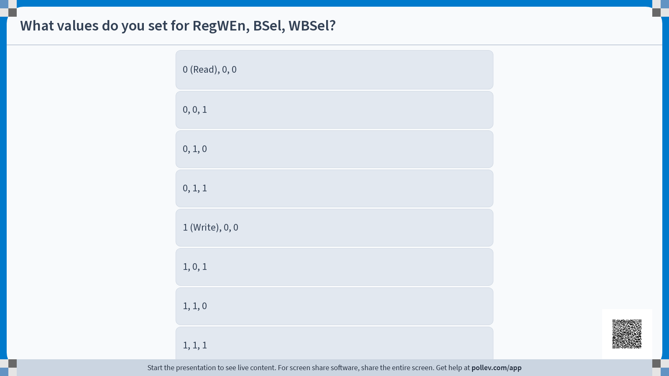

Slide 19
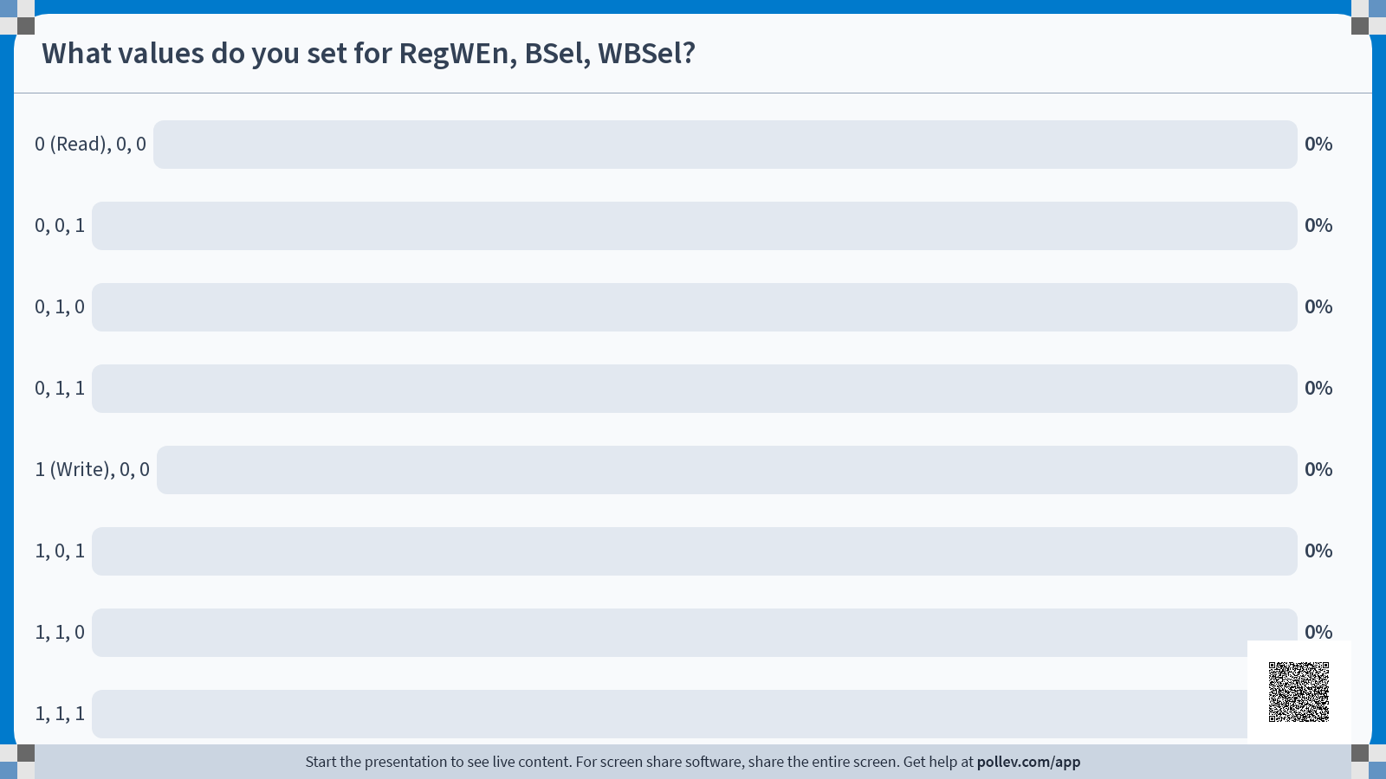

Slide 20
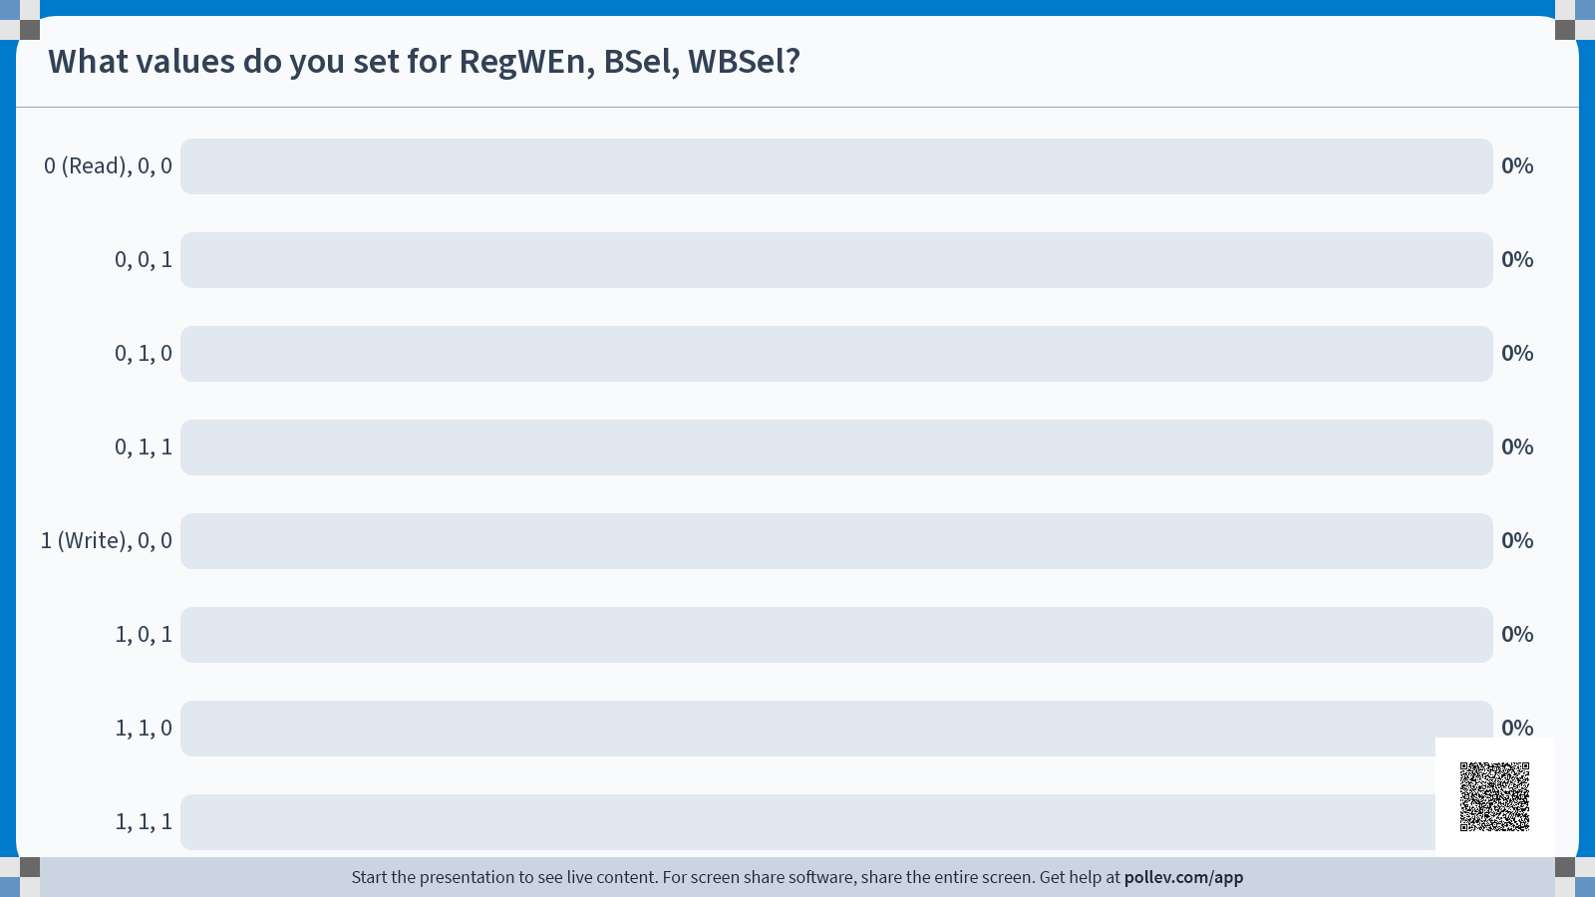

Slide 21
Datapath running sw s0 24(sp): Write Back
4
0x7FFF FFF8
+
0x00812C23
dataW
rsW
rs1 data1
rs2
data2
Reg[]
dataR
addr
IMEM
8
A
ALU
B
PC
0x7FFF FFE0
2
8
0x7FFF FFF8
1
0
dataR
addr
DMEM
dataW
0
DMEM will update on the clock tick. Since we DON'T want any register to change, we need RegWEn to be off. WBSel can be any value (denoted by *); example shows WBSel of 1.
24
0xDEAD BEEF
ImmGen
50
1
ADD
S
0
1
Write
*
Control Logic

Slide 22
DMEM Limitations Affect our Circuit: Stores
As with loads, DMEM's limitations affect our circuit design.
General approach:
Determine which word contains the data we will store
As with loads, no store to two separate words
Manipulate the data to align with the right bytes
Left-shifts according to the endianness
Use separate read/write bits for each byte, so you don't overwrite unnecessary data
Exact implementation is an exercise in Project 3, and will be omitted for this lecture

Slide 23
Agenda
Implementing Loads
Implementing Stores
Implementing Jumps
Implementing Branches
Implementing U-types
Implementing ImmGen

Slide 24
Implementing the jal instruction
Let's add jal
jal computes one thing:
New PC = PC + offset
Goal: Make the ALU do this math
And affects two state elements:
rd =PC+4
PC = PC+offset
Main issues:
ImmGen needs to handle J-type immediates (including adding the implicit 0)
WB to RegFile needs to include PC+4
WB to PC needs to include PC+offset
Send PC into ALU so it can compute PC+offset

Slide 25
Datapath so far
+
4
dataW
rsW
rs1 data1
rs2
data2
Reg[]
dataR
addr
IMEM
A
ALU
B
PC
1
0
dataR
addr
DMEM
dataW
0
ImmGen
1
ALUSel
ImmSel
RegWEn
MEMRW
BSel
WBSel
Control Logic

Slide 26
Datapath running jal x1 100: Add ImmSel for J
+
4
0x064000EF
dataW
rsW
rs1 data1
rs2
data2
Reg[]
dataR
addr
IMEM
1
A
ALU
B
PC
0
0
4
0
1
0
dataR
addr
DMEM
dataW
0
ImmGen can create immediate from instruction; exact way to do that will be discussed later! As before, rs1 and rs2 are garbage from reading parts of the instruction incorrectly
100
ImmGen
1
J
Control Logic

Slide 27
Datapath running jal x1 100: Computing PC+offset in ALU
0
+
4
1
0x064000EF
dataW
rsW
rs1 data1
rs2
data2
Reg[]
dataR
addr
IMEM
1
0
A
ALU
B
PC
0
4
0
100
1
dataR
addr
DMEM
dataW
0
0
0
Add an A Mux that receives PC and can be used instead of rs1. ASel can be handled by control logic
100
ImmGen
1
ADD
J
1
1
Control Logic

Slide 28
Datapath running jal x1 100: Setting PC to PC+Offset
0
+
4
1
0x064000EF
dataW
rsW
rs1 data1
rs2
data2
Reg[]
dataR
addr
IMEM
1
0
A
ALU
B
0
PC
0
1
100
0
100
4
1
dataR
addr
DMEM
dataW
0
0
0
Add a PC Mux connected to PC+4 and ALU output
100
ImmGen
1
ADD
1
J
1
1
Control Logic

Slide 29
Datapath running jal x1 100: Setting rd to PC+4
0
+
4
4
1
0x064000EF
dataW
rsW
rs1 data1
rs2
data2
Reg[]
dataR
addr
IMEM
1
0
A
ALU
B
4
0
PC
0
2
1
100
0
100
4
1
dataR
addr
DMEM
dataW
0
0
0
Add a WB Mux input for PC+4. Set MEMRW to 0 to avoid changing memory
100
ImmGen
1
ADD
1
J
1
1
1
0
2
Control Logic

Slide 30
Datapath running jalr x1 x5 100
+
4
4
1
0x064280E7
dataW
rsW
rs1 data1
rs2
data2
Reg[]
dataR
addr
IMEM
1
0
A
ALU
B
4
0
PC
5
2
120
0
120
1
4
20
1
dataR
addr
DMEM
dataW
0
0
0
By switching ImmSel and ASel, can also run jalr instructions
100
ImmGen
1
ADD
1
I
1
0
1
0
2
Control Logic

Slide 31
Agenda
Implementing Loads
Implementing Stores
Implementing Jumps
Implementing Branches
Implementing U-types
Implementing ImmGen

Slide 32
Implementing branch instructions
Let's add beq
beq compares rs1 and rs2:
Need new component for comparisons
Then computes one thing:
New PC if branch = PC+offset
This uses the ALU, so can't use ALU for comparisons - need new block!
Then sets one state element:
PC+4 if branch not taken, PC+offset if branch is taken
Can use PCSel
Main issues:
Control logic (PCSel) needs to be conditioned on Branch result
New immediate type
New Branch Comparator

Slide 33
The Branch Comparator
The Branch Comparator will handle all our branch instructions:
Input:
Two data busses A and B (corresponding to rs1 and rs2)
BrUn control bit: Do unsigned comparison?
Only affects BrLt, since == is the same regardless of signed vs unsigned
Output:
Two bits:
BrEq that's 1 if A==B
BrLt that's 1 if A < B
Note: A>=B is the same as !(A<B), so no need for BrGe
Can decide PCSel based on these outputs, so send to Control Logic
Branch Comp
32
32
BrUn
Eq
Lt

Slide 34
Datapath so far
+
4
1
dataW
rsW
rs1 data1
rs2
data2
Reg[]
dataR
addr
IMEM
0
A
ALU
B
0
PC
2
1
1
dataR
addr
DMEM
dataW
0
0
ImmGen
1
ALUSel
PC Sel
ImmSel
RegWEn
MEMRW
BSel
ASel
WBSel
Control Logic

Slide 35
Datapath running beq x5 x6 16 (equality holds)
+
4
1
0x00628863
dataW
rsW
rs1 data1
rs2
data2
Reg[]
16
dataR
addr
IMEM
16
A
ALU
B
PC
0
0
5
2
Branch Comp
1
16
0
3
6
3
1
dataR
addr
DMEM
dataW
PCSel depends on the result of Branch Comparator; either the pink or the orange path gets used, though both get computed
0
0
ImmGen
16
1
ADD
PC Sel
0
Read
B
1
1
*
*
Control Logic

Slide 36
Datapath running beq x5 x6 16 (equality does not hold)
+
4
1
0x00628863
dataW
rsW
rs1 data1
rs2
data2
Reg[]
16
dataR
addr
IMEM
16
A
ALU
B
PC
0
0
5
2
Branch Comp
1
4
0
3
6
2
1
dataR
addr
DMEM
dataW
RegWEn and MEMRW need to disable writes, since we don't want to change anything except PC.
0
0
ImmGen
16
1
ADD
PC Sel
0
Read
B
1
1
*
*
Control Logic

Slide 37
Agenda
Implementing Loads
Implementing Stores
Implementing Jumps
Implementing Branches
Implementing U-types
Implementing ImmGen

Slide 38
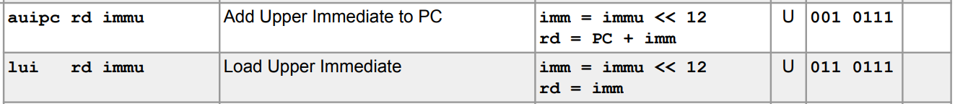
Implementing lui
Let's add lui
lui computes a new immediate type
And affects two state elements:
rd = imm
PC = PC+4

Slide 39
Implementing auipc
auipc does the same thing as lui, but it also adds PC to the immediate value

Slide 40
Datapath So Far
+
4
1
dataW
rsW
rs1 data1
rs2
data2
Reg[]
dataR
addr
IMEM
0
A
ALU
B
0
PC
Branch Comp
2
1
1
dataR
addr
DMEM
dataW
0
0
ImmGen
1
ALUSel
PC Sel
ImmSel
RegWEn
MEMRW
ASel
WBSel
BSel
BrUn
BrLt
Control Logic
BrEq

Slide 41
Datapath running lui x5 0x12345
0x1234 5000
+
4
1
0x123452B7
dataW
rsW
rs1 data1
rs2
data2
Reg[]
dataR
addr
IMEM
5
A
ALU
B
PC
0
0
2
Branch Comp
1
1
dataR
addr
DMEM
dataW
0
lui doesn't need many changes! All we need is a new ImmGen format and a new ALU operation: return value of B.
0
ImmGen
0x1234 5000
1
0
Read
1
U
1
1
*
B
*
Control Logic

Slide 42
Datapath running auipc x5 0x12345
0x1234 5000
+
4
1
0x12345297
dataW
rsW
rs1 data1
rs2
data2
Reg[]
dataR
addr
IMEM
5
A
ALU
B
PC
0
0
2
Branch Comp
1
1
dataR
addr
DMEM
dataW
0
auipc also gets implemented with no changes, by using the PC input we set for jal instructions!
0
ImmGen
0x1234 5000
1
0
Read
1
U
1
1
1
ADD
*
Control Logic

Slide 43
Complete RISC-V Datapath!!!
+
4
1
dataW
rsW
rs1 data1
rs2
data2
Reg[]
dataR
addr
IMEM
0
A
ALU
B
0
PC
Branch Comp
2
1
1
dataR
addr
DMEM
dataW
0
0
ImmGen
1
ALUSel
PC Sel
ImmSel
RegWEn
MEMRW
ASel
WBSel
BSel
BrUn
BrLt
Control Logic
BrEq

Slide 44
Agenda
Implementing Loads
Implementing Stores
Implementing Jumps
Implementing Branches
Implementing U-types
Implementing ImmGen

Slide 45
What's Left?
With the datapath we have, we've reduced the problem of making a CPU to a few small subcircuits:
Multiplexers: Discussed in Lecture 17, and part of Lab 5
ALU/Regfile: Implemented as part of Project 3A
Branch Comparator: Implemented as part of Project 3B
IMEM/DMEM: Exact implementation out of scope
Control Logic: The big one
All of Monday's lecture
ImmGen: Let's finish this off right now
At the same time, we'll notice some clever patterns in how the bits are stored across instruction formats

Slide 46
How to make the ImmGen
Option 1:
Make a circuit for each instruction format, then mux the results with ImmSel
Ugly, but it works
Option 2:
Look for patterns in the instruction format
Takes time, but gives much greater insight into why instruction formats were designed this way

Slide 47
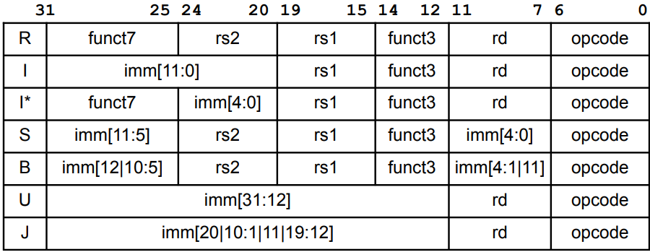
Instruction Formats

Slide 48
Tracking all Immediate Bits in each format
Imm | 31 | 30 | 29 | 28 | 27 | 26 | 25 | 24 | 23 | 22 | 21 | 20 | 19 | 18 | 17 | 16 | 15 | 14 | 13 | 12 | 11 | 10 | 9 | 8 | 7 | 6 | 5 | 4 | 3 | 2 | 1 | 0
I | 11 | 10 | 9 | 8 | 7 | 6 | 5 | 4 | 3 | 2 | 1 | 0
S | 11 | 10 | 9 | 8 | 7 | 6 | 5 |  |  |  |  |  |  |  |  |  |  |  |  |  | 4 | 3 | 2 | 1 | 0
B | 12 | 10 | 9 | 8 | 7 | 6 | 5 |  |  |  |  |  |  |  |  |  |  |  |  |  | 4 | 3 | 2 | 1 | 11
U | 31 | 30 | 29 | 28 | 27 | 26 | 25 | 24 | 23 | 22 | 21 | 20 | 19 | 18 | 17 | 16 | 15 | 14 | 13 | 12
J | 20 | 10 | 9 | 8 | 7 | 6 | 5 | 4 | 3 | 2 | 1 | 11 | 19 | 18 | 17 | 16 | 15 | 14 | 13 | 12

Slide 49
Tracking all Immediate Bits in each format
Imm | 31 | 30 | 29 | 28 | 27 | 26 | 25 | 24 | 23 | 22 | 21 | 20 | 19 | 18 | 17 | 16 | 15 | 14 | 13 | 12 | 11 | 10 | 9 | 8 | 7 | 6 | 5 | 4 | 3 | 2 | 1 | 0
Bit 0 of imm: Bit 20 of inst if I type, Bit 7 of inst if S type, always 0 if B/U/J type
I | 11 | 10 | 9 | 8 | 7 | 6 | 5 | 4 | 3 | 2 | 1 | 0
S | 11 | 10 | 9 | 8 | 7 | 6 | 5 |  |  |  |  |  |  |  |  |  |  |  |  |  | 4 | 3 | 2 | 1 | 0
B | 12 | 10 | 9 | 8 | 7 | 6 | 5 |  |  |  |  |  |  |  |  |  |  |  |  |  | 4 | 3 | 2 | 1 | 11
U | 31 | 30 | 29 | 28 | 27 | 26 | 25 | 24 | 23 | 22 | 21 | 20 | 19 | 18 | 17 | 16 | 15 | 14 | 13 | 12
J | 20 | 10 | 9 | 8 | 7 | 6 | 5 | 4 | 3 | 2 | 1 | 11 | 19 | 18 | 17 | 16 | 15 | 14 | 13 | 12

Slide 50
Tracking all Immediate Bits in each format
Imm | 31 | 30 | 29 | 28 | 27 | 26 | 25 | 24 | 23 | 22 | 21 | 20 | 19 | 18 | 17 | 16 | 15 | 14 | 13 | 12 | 11 | 10 | 9 | 8 | 7 | 6 | 5 | 4 | 3 | 2 | 1 | 0
Bits 4-1 of imm: Bits 24-21 of inst if I/J type, Bits 11-8 of inst if S/B type, always 0 if U type. Only found in two parts of the instruction, and these 4 bits are always together.
I | 11 | 10 | 9 | 8 | 7 | 6 | 5 | 4 | 3 | 2 | 1 | 0
S | 11 | 10 | 9 | 8 | 7 | 6 | 5 |  |  |  |  |  |  |  |  |  |  |  |  |  | 4 | 3 | 2 | 1 | 0
B | 12 | 10 | 9 | 8 | 7 | 6 | 5 |  |  |  |  |  |  |  |  |  |  |  |  |  | 4 | 3 | 2 | 1 | 11
U | 31 | 30 | 29 | 28 | 27 | 26 | 25 | 24 | 23 | 22 | 21 | 20 | 19 | 18 | 17 | 16 | 15 | 14 | 13 | 12
J | 20 | 10 | 9 | 8 | 7 | 6 | 5 | 4 | 3 | 2 | 1 | 11 | 19 | 18 | 17 | 16 | 15 | 14 | 13 | 12

Slide 51
Tracking all Immediate Bits in each format
Imm | 31 | 30 | 29 | 28 | 27 | 26 | 25 | 24 | 23 | 22 | 21 | 20 | 19 | 18 | 17 | 16 | 15 | 14 | 13 | 12 | 11 | 10 | 9 | 8 | 7 | 6 | 5 | 4 | 3 | 2 | 1 | 0
Bits 10-5 of imm: Bits 30-25 of inst if I/S/B/J type, always 0 if U type. Only found in one part of the instruction, even though 4 different instruction formats use it!
I | 11 | 10 | 9 | 8 | 7 | 6 | 5 | 4 | 3 | 2 | 1 | 0
S | 11 | 10 | 9 | 8 | 7 | 6 | 5 |  |  |  |  |  |  |  |  |  |  |  |  |  | 4 | 3 | 2 | 1 | 0
B | 12 | 10 | 9 | 8 | 7 | 6 | 5 |  |  |  |  |  |  |  |  |  |  |  |  |  | 4 | 3 | 2 | 1 | 11
U | 31 | 30 | 29 | 28 | 27 | 26 | 25 | 24 | 23 | 22 | 21 | 20 | 19 | 18 | 17 | 16 | 15 | 14 | 13 | 12
J | 20 | 10 | 9 | 8 | 7 | 6 | 5 | 4 | 3 | 2 | 1 | 11 | 19 | 18 | 17 | 16 | 15 | 14 | 13 | 12

Slide 52
Tracking all Immediate Bits in each format
Imm | 31 | 30 | 29 | 28 | 27 | 26 | 25 | 24 | 23 | 22 | 21 | 20 | 19 | 18 | 17 | 16 | 15 | 14 | 13 | 12 | 11 | 10 | 9 | 8 | 7 | 6 | 5 | 4 | 3 | 2 | 1 | 0
MSB of instruction is ALWAYS the MSB of the instruction. Sign-extending is just copying the MSB, and almost all RISC-V immediates sign-extend. To sign-extend, we just take the MSB of the instruction.
I | 11 | 10 | 9 | 8 | 7 | 6 | 5 | 4 | 3 | 2 | 1 | 0
S | 11 | 10 | 9 | 8 | 7 | 6 | 5 |  |  |  |  |  |  |  |  |  |  |  |  |  | 4 | 3 | 2 | 1 | 0
B | 12 | 10 | 9 | 8 | 7 | 6 | 5 |  |  |  |  |  |  |  |  |  |  |  |  |  | 4 | 3 | 2 | 1 | 11
U | 31 | 30 | 29 | 28 | 27 | 26 | 25 | 24 | 23 | 22 | 21 | 20 | 19 | 18 | 17 | 16 | 15 | 14 | 13 | 12
J | 20 | 10 | 9 | 8 | 7 | 6 | 5 | 4 | 3 | 2 | 1 | 11 | 19 | 18 | 17 | 16 | 15 | 14 | 13 | 12

Slide 53
Tracking all Immediate Bits in each format
Imm | 31 | 30 | 29 | 28 | 27 | 26 | 25 | 24 | 23 | 22 | 21 | 20 | 19 | 18 | 17 | 16 | 15 | 14 | 13 | 12 | 11 | 10 | 9 | 8 | 7 | 6 | 5 | 4 | 3 | 2 | 1 | 0
Bits 31-21 and 19-12 of immediate: Always the corresponding bit in the instruction if part of the format, and bit 31 otherwise. Only two options for these bits as well
I | 11 | 10 | 9 | 8 | 7 | 6 | 5 | 4 | 3 | 2 | 1 | 0
S | 11 | 10 | 9 | 8 | 7 | 6 | 5 |  |  |  |  |  |  |  |  |  |  |  |  |  | 4 | 3 | 2 | 1 | 0
B | 12 | 10 | 9 | 8 | 7 | 6 | 5 |  |  |  |  |  |  |  |  |  |  |  |  |  | 4 | 3 | 2 | 1 | 11
U | 31 | 30 | 29 | 28 | 27 | 26 | 25 | 24 | 23 | 22 | 21 | 20 | 19 | 18 | 17 | 16 | 15 | 14 | 13 | 12
J | 20 | 10 | 9 | 8 | 7 | 6 | 5 | 4 | 3 | 2 | 1 | 11 | 19 | 18 | 17 | 16 | 15 | 14 | 13 | 12

Slide 54
Tracking all Immediate Bits in each format
Imm | 31 | 30 | 29 | 28 | 27 | 26 | 25 | 24 | 23 | 22 | 21 | 20 | 19 | 18 | 17 | 16 | 15 | 14 | 13 | 12 | 11 | 10 | 9 | 8 | 7 | 6 | 5 | 4 | 3 | 2 | 1 | 0
Bits 20 and 11 of immediate: Kind of put in random spots where there's space. Bit 20 needs a 3-way mux, and bit 11 needs a 4-way mux
I | 11 | 10 | 9 | 8 | 7 | 6 | 5 | 4 | 3 | 2 | 1 | 0
S | 11 | 10 | 9 | 8 | 7 | 6 | 5 |  |  |  |  |  |  |  |  |  |  |  |  |  | 4 | 3 | 2 | 1 | 0
B | 12 | 10 | 9 | 8 | 7 | 6 | 5 |  |  |  |  |  |  |  |  |  |  |  |  |  | 4 | 3 | 2 | 1 | 11
U | 31 | 30 | 29 | 28 | 27 | 26 | 25 | 24 | 23 | 22 | 21 | 20 | 19 | 18 | 17 | 16 | 15 | 14 | 13 | 12
J | 20 | 10 | 9 | 8 | 7 | 6 | 5 | 4 | 3 | 2 | 1 | 11 | 19 | 18 | 17 | 16 | 15 | 14 | 13 | 12

Slide 55
How to make the ImmGen
Because of how all instruction formats were chosen, there are a lot of underlying patterns in how immediates are stored.
By looking for these patterns, the ImmGen can be greatly simplified (in terms of total number of logic gates)
6-select 32-bit mux = 640 logic gates (counting 2-input OR and ANDs, and 1-input NOTs)
Using just muxes for each set of bits, you can get this down to 160 logic gates
Con: Makes it harder to extend your CPU. Often not worth it to optimize this too much
Exact details left for Project 3B

Slide 56
Complete RISC-V Datapath!
+
4
1
dataW
rsW
rs1 data1
rs2
data2
Reg[]
dataR
addr
IMEM
0
A
ALU
B
0
PC
Branch Comp
2
1
1
dataR
addr
DMEM
dataW
0
0
ImmGen
1
ALUSel
PC Sel
ImmSel
RegWEn
MEMRW
ASel
WBSel
BSel
BrUn
BrLt
Control Logic
BrEq

